Slide 1




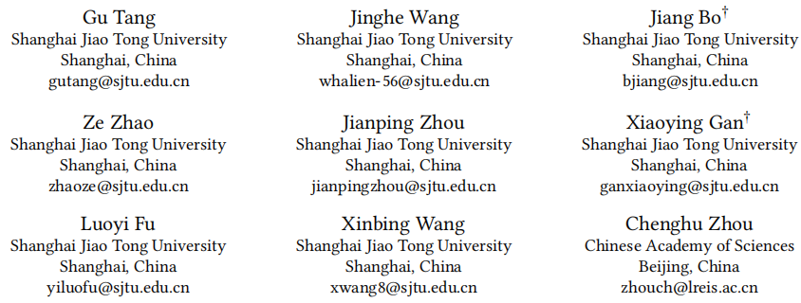





ATAI
Advanced Technique of Artificial Intelligence
ATAI
ChongqingUniversity _{AdvancedTechniqueof}
of Technology Artificial Intelligence
Chongqing University of Technology
Chongqing University ^{ATAI}
_{of Technology} Advanced Techniqueof
Artificial Intelligence
Chongqing University of Technology
Chongqing University of Technology
TargetMR: Learning Modality Target for Multimodal Recommendation
code: https://github.com/gutang-97/TargetMR/
—— WWW ’26
Reported by Junsi Chen
1

Slide 2

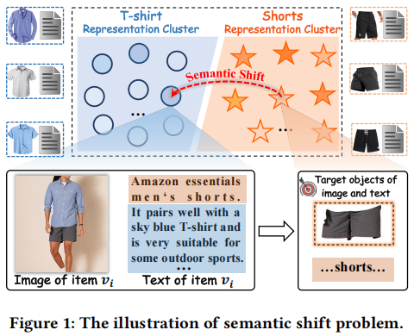
ATAI
AdvancedTechniqueof
Artificial Intelligence
ATAI
ChongqingUniversity _{AdvancedTechniqueof}
of Technology Artificial Intelligence
ChongqingUniversity of Technology
Motivation
(1) Existing MRSs still suffer from the semantic shift problem.

Slide 3

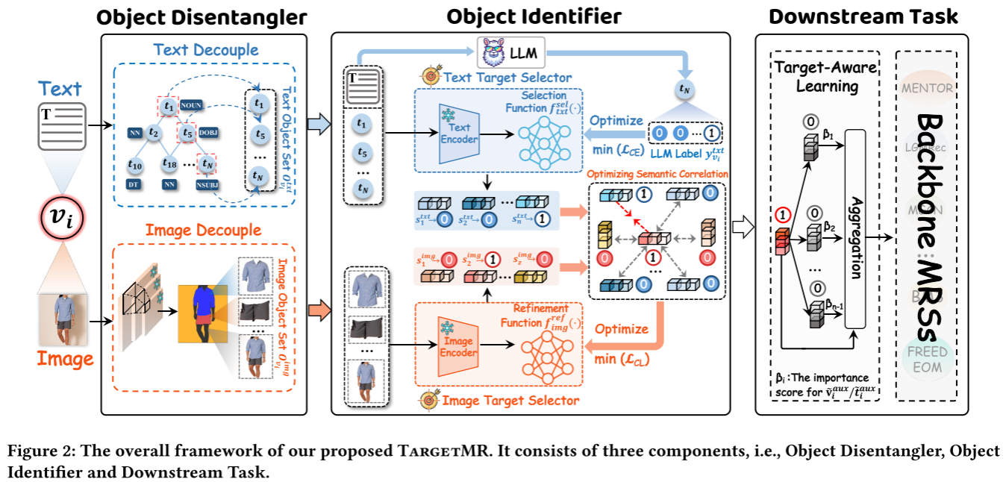
ChongqingUniversity of Technology
ATAI
AdvancedTechniqueof
Artificial Intelligence
ATAI
ChongqingUniversity _{AdvancedTechniqueof}
of Technology Artificial Intelligence
Overview

Slide 4
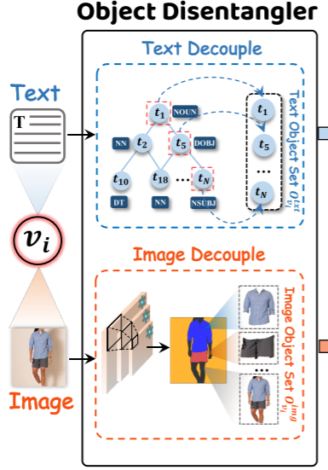



ChongqingUniversity of Technology
ATAI
AdvancedTechniqueof
Artificial Intelligence
ATAI
ChongqingUniversity _{AdvancedTechniqueof}
of Technology Artificial Intelligence
Method
(1)
(2)
(3)
(4)
(5)

Slide 5
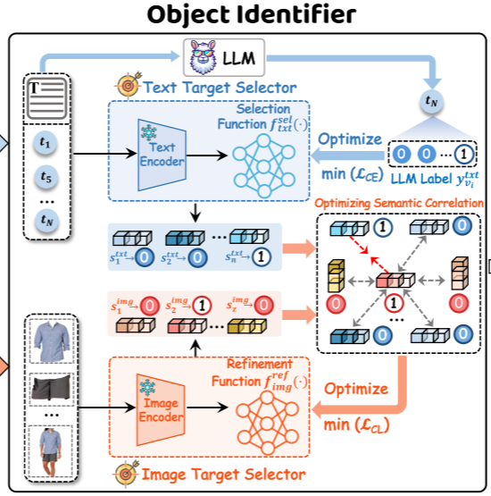



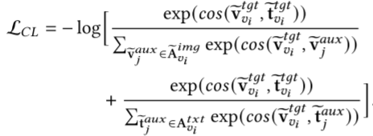
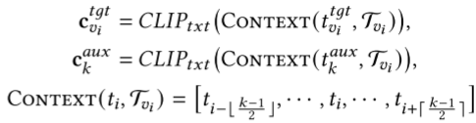

ChongqingUniversity of Technology
ATAI
AdvancedTechniqueof
Artificial Intelligence
ATAI
ChongqingUniversity _{AdvancedTechniqueof}
of Technology Artificial Intelligence
Method
(6)
(15)
(7)
(16)
(8)
(17)
(9)
(18)
(10)
(11)
(19)
(12)
(13)
(14)

Slide 6
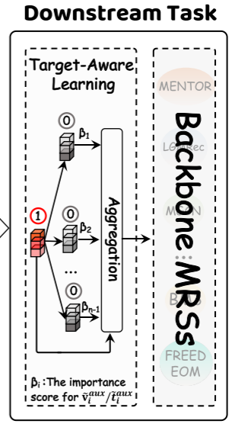



ChongqingUniversity of Technology
ATAI
AdvancedTechniqueof
Artificial Intelligence
ATAI
ChongqingUniversity _{AdvancedTechniqueof}
of Technology Artificial Intelligence
Method
(20)
(21)
(22)
(23)

Slide 7

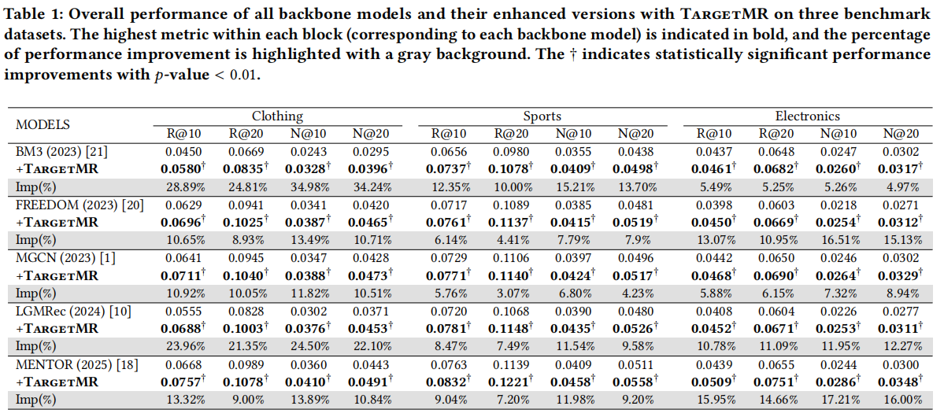
ATAI
Advanced Technique of Artificial Intelligence
ATAI
ChongqingUniversity _{AdvancedTechniqueof}
of Technology Artificial Intelligence
Chongqing University of
Technology
Chongqing University ^{ATAI}
_{of Technology} Advanced Techniqueof
Artificial Intelligence
Chongqing University of Technology
Chongqing University of Technology

Slide 8
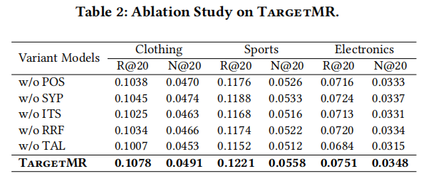
ATAI
Advanced Technique of Artificial Intelligence
ATAI
ChongqingUniversity _{AdvancedTechniqueof}
of Technology Artificial Intelligence
Chongqing University of
Technology
Chongqing University ^{ATAI}
_{of Technology} Advanced Techniqueof
Artificial Intelligence
Chongqing University of Technology
Chongqing University of Technology

Slide 9
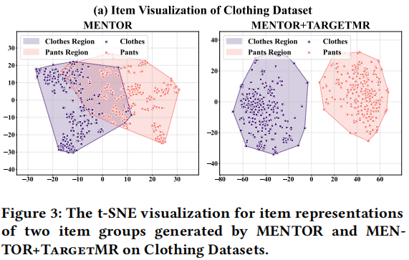
ATAI
Advanced Technique of Artificial Intelligence
ATAI
ChongqingUniversity _{AdvancedTechniqueof}
of Technology Artificial Intelligence
Chongqing University of
Technology
Chongqing University ^{ATAI}
_{of Technology} Advanced Techniqueof
Artificial Intelligence
Chongqing University of Technology
Chongqing University of Technology

Slide 10
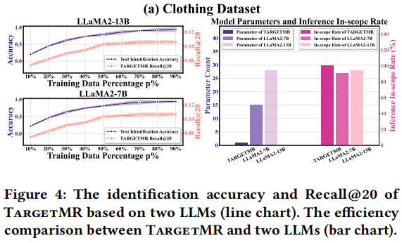
ATAI
Advanced Technique of Artificial Intelligence
ATAI
ChongqingUniversity _{AdvancedTechniqueof}
of Technology Artificial Intelligence
Chongqing University of
Technology
Chongqing University ^{ATAI}
_{of Technology} Advanced Techniqueof
Artificial Intelligence
Chongqing University of Technology
Chongqing University of Technology

Slide 11
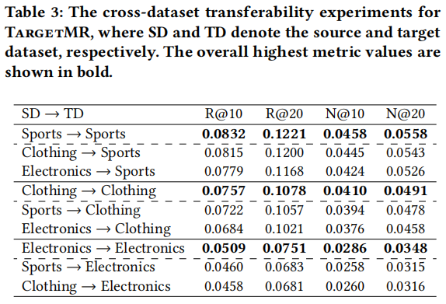
ATAI
Advanced Technique of Artificial Intelligence
ATAI
ChongqingUniversity _{AdvancedTechniqueof}
of Technology Artificial Intelligence
Chongqing University of
Technology
Chongqing University ^{ATAI}
_{of Technology} Advanced Techniqueof
Artificial Intelligence
Chongqing University of Technology
Chongqing University of Technology

Slide 12
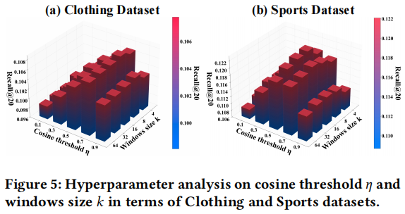
ATAI
Advanced Technique of Artificial Intelligence
ATAI
ChongqingUniversity _{AdvancedTechniqueof}
of Technology Artificial Intelligence
Chongqing University of
Technology
Chongqing University ^{ATAI}
_{of Technology} Advanced Techniqueof
Artificial Intelligence
Chongqing University of Technology
Chongqing University of Technology

Slide 13
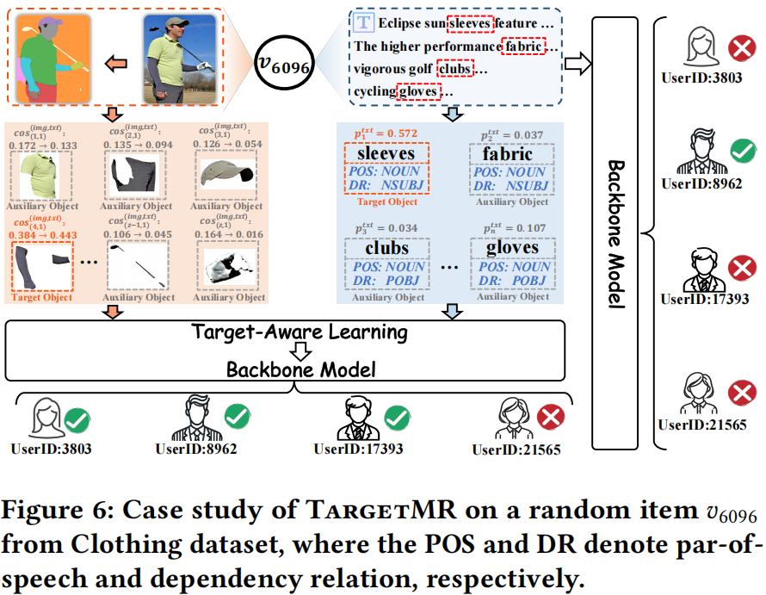
ATAI
Advanced Technique of Artificial Intelligence
ATAI
ChongqingUniversity _{AdvancedTechniqueof}
of Technology Artificial Intelligence
Chongqing University of
Technology
Chongqing University ^{ATAI}
_{of Technology} Advanced Techniqueof
Artificial Intelligence
Chongqing University of Technology
Chongqing University of Technology

Slide 14


ATAI
Advanced Technique of
Artificial Intelligence
ATAI
ChongqingUniversity _{AdvancedTechniqueof}
of Technology Artificial Intelligence
Chongqing University of Technology
Thanks!

